Slide 1
Using data for stories
USC
Jennifer LaFleur, ProPublica
Coulter Jones, The Center for
Investigative Reporting

Slide 2
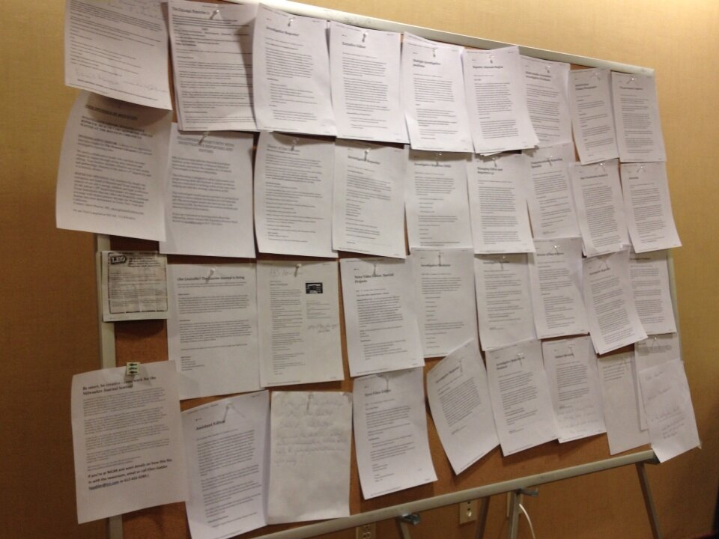
Get hired after school
Notes:
2

Slide 3
Why data?
It takes you beyond the anecdote
It’s easier than counting sheets of paper
It lets you find stories that otherwise would be missed

Slide 4
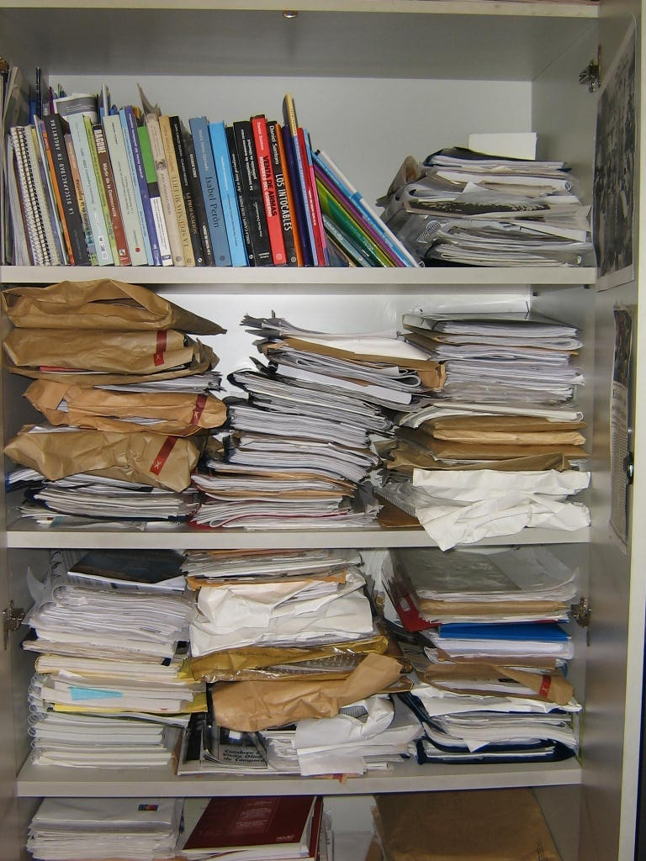

Slide 5
Why data?
Contrasts are in the data

Slide 6
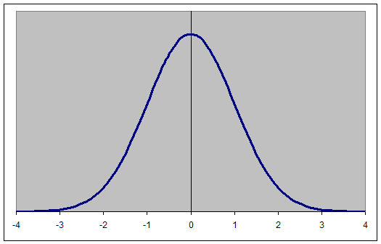
Caution: This slide contains extreme nerdiness

Slide 8
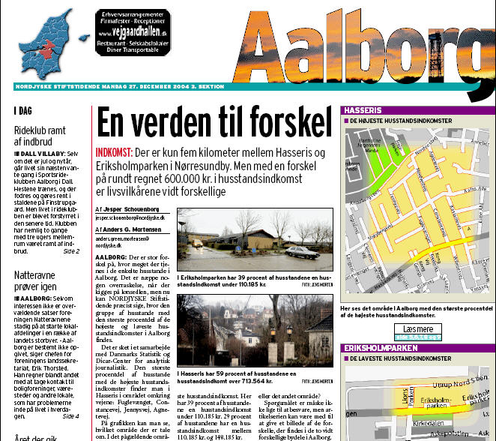

Slide 9
Why Computer-Assisted Reporting?
Contrasts are in the data
Your most powerful figures are in the data

Slide 10
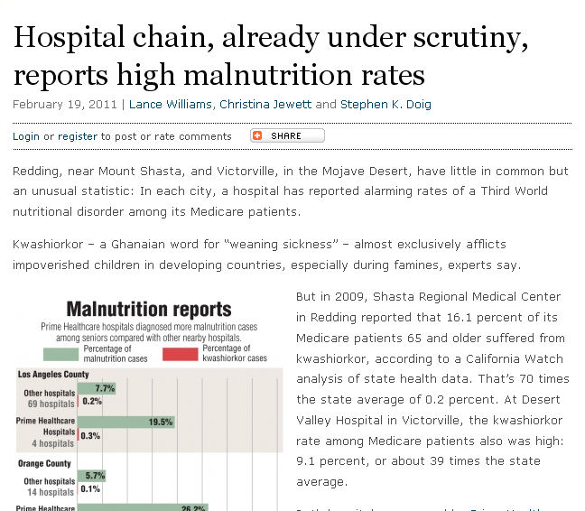
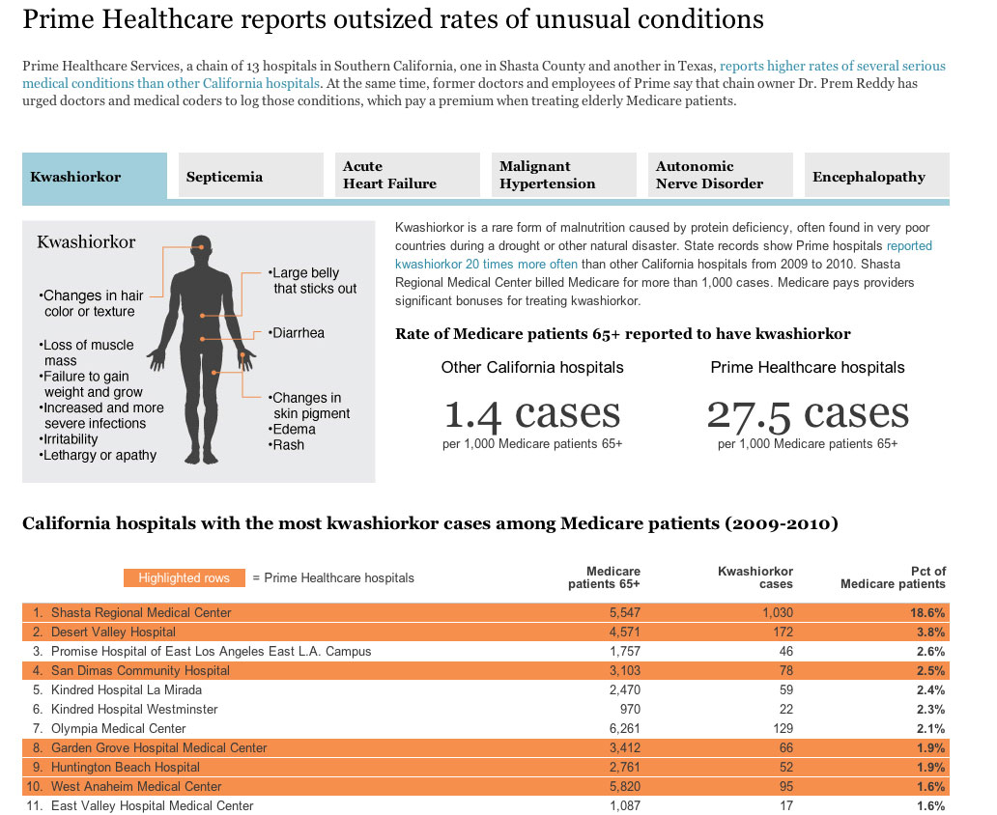
Source: California Health Dept. data, Medicare billing data
Findings: Some hospitals had “alarming rates of a Third World nutritional disorder among its Medicare patients.”

Slide 11
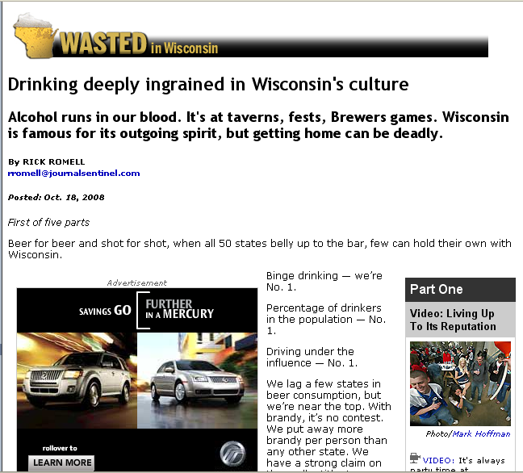

Slide 12
Why data?
Contrasts are in the data
Your most powerful figures are in the data
You can make connections you might not be able to make otherwise

Slide 13
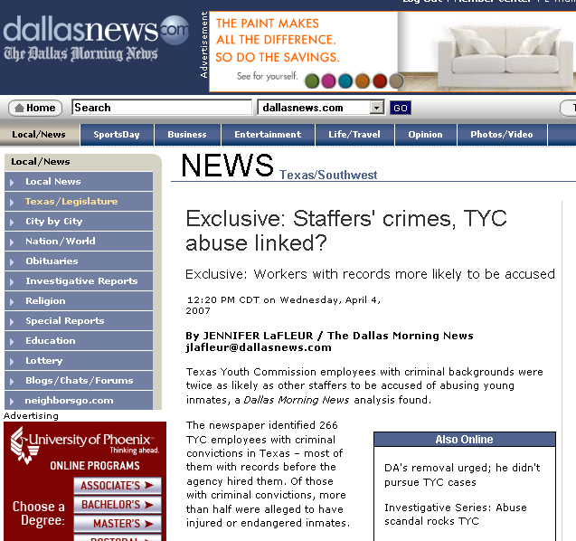
Data: Youth prison workers, criminal convictions and grievance data
Findings: Employees with criminal backgrounds were more likely to be accused of abusing inmates.

Slide 14
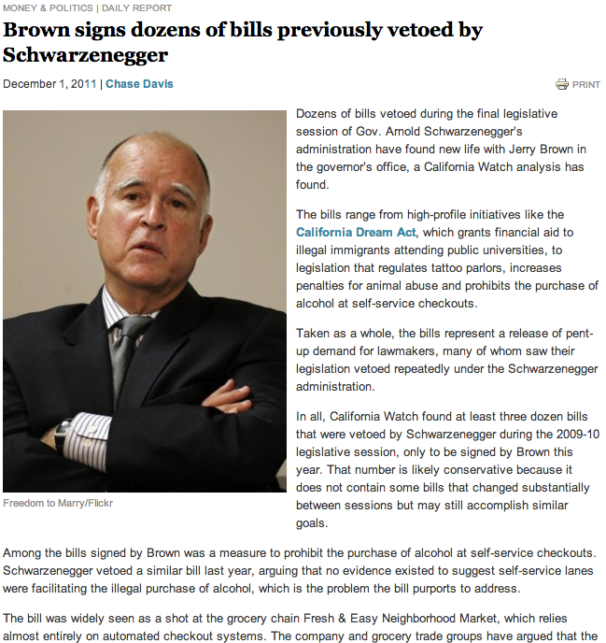
Findings: Gov. Brown signed dozens of bills that Schwarzenegger had vetoed.
Method: Comparative text analysis of bills, not by sponsor or bill name.
Notes:
14

Slide 15
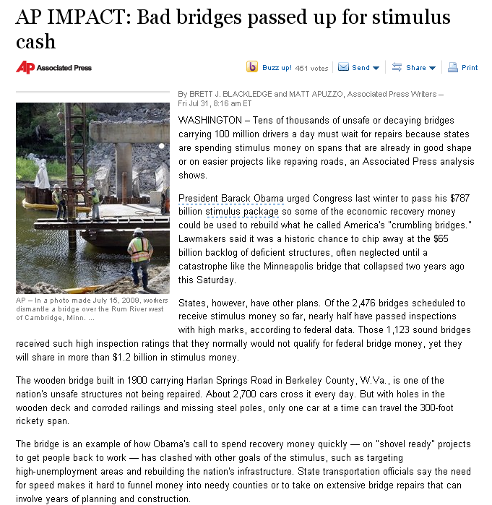
Data: Federal bridge inspections and stimulus funding.
Findings: Some of the nation’s worst bridges did not get stimulus funds.

Slide 16
Why data?
Contrasts are in the data
Your most powerful figures are in the data
You can make connections you might not be able to make otherwise
You can test assumptions

Slide 17
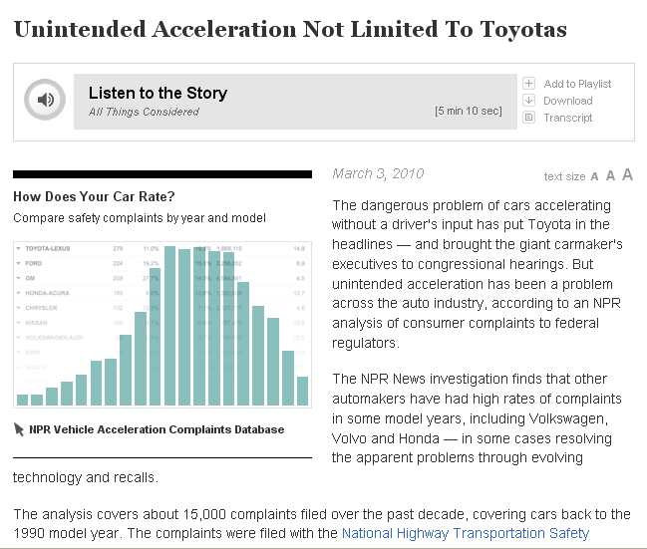
Source: NHTSA complaint data
Findings: “…unintended acceleration has been a problem across the auto industry.”

Slide 18
Collecting the data

Slide 19
Where’s the data?
If something is inspected
Licensed
Enforced or
Purchased
…There probably is a database

Slide 20
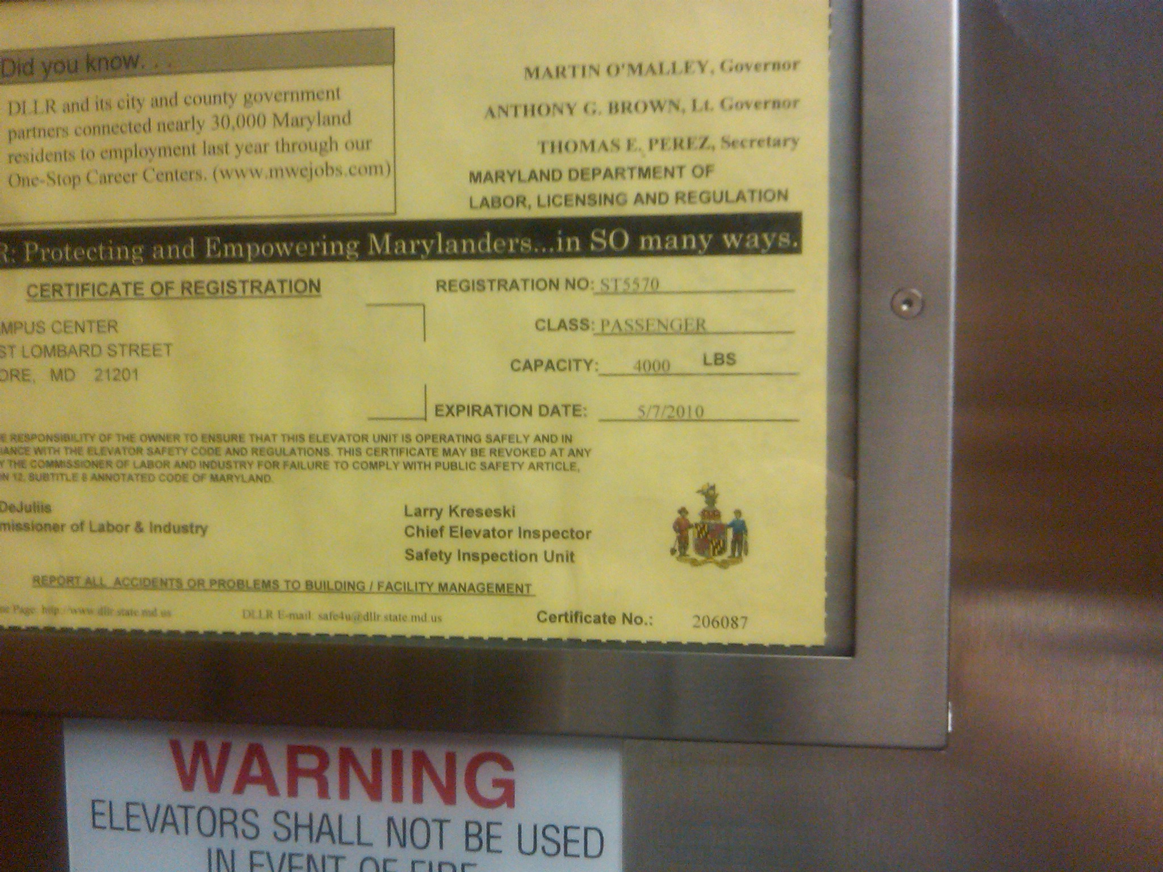

Slide 21
Where’s the data?
If there is a report
Or a form
There probably is a database

Slide 22
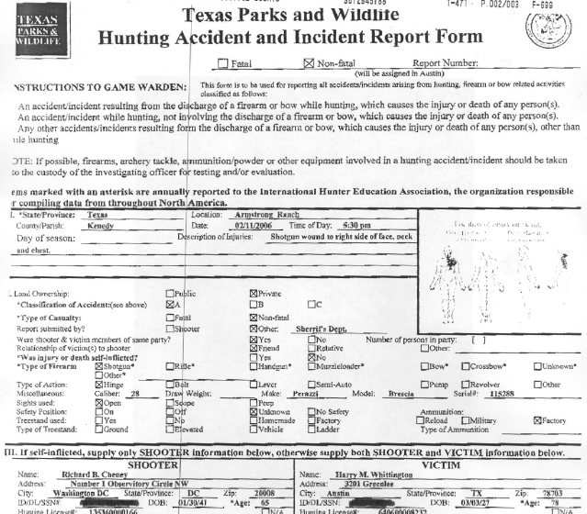
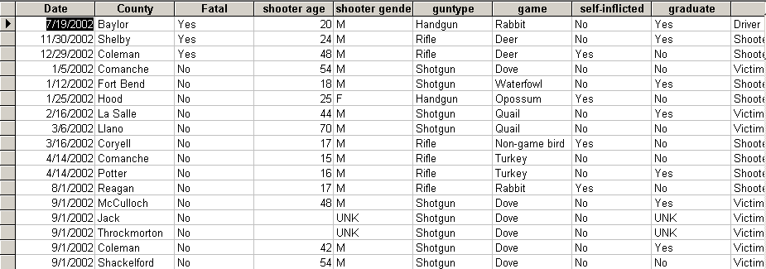

Slide 23
Where’s the data?
Sometimes data is readily available online for download

Slide 24
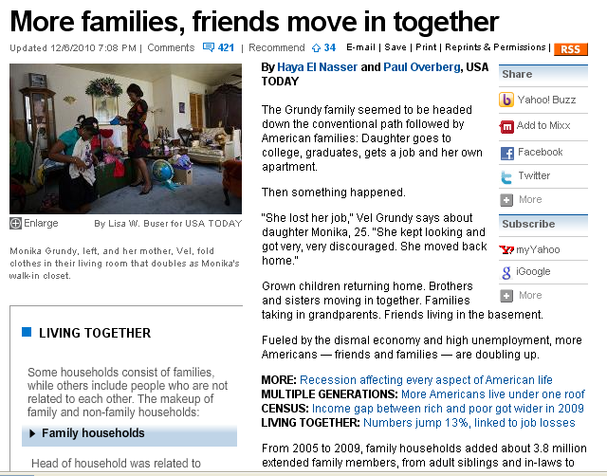
Source: Census
Findings: “Fueled by the dismal economy and high unemployment, more Americans…are doubling up”

Slide 25
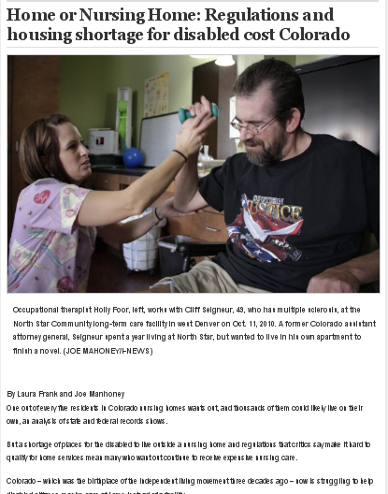
Source: Medicaid nursing home survey data and finance data, housing data
Findings: “…a shortage of places for the disabled to live outside a nursing home and regulations that critics say make it hard to qualify for home services mean many who want out continue to receive expensive nursing care.”

Slide 26
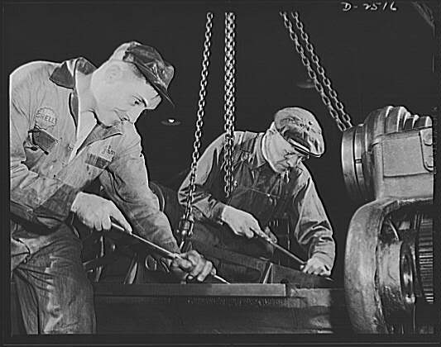
Where’s the data?
Sometimes you have to scrape it.
That usually involves programs that automate searching tasks on Web sites.

Slide 27
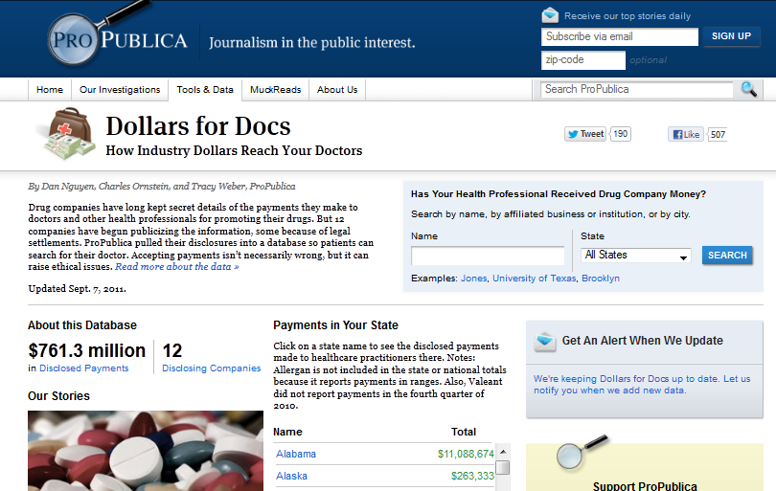

Slide 28
Where’s the data?
More often you need to go to an agency to get the data
This can be tricky if an agency doesn’t want to release it.

Slide 29
Source: School district credit card purchases
Findings: District card holders made questionable purchases with their cards.

Slide 30
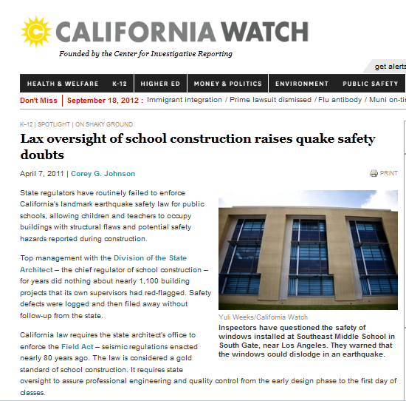
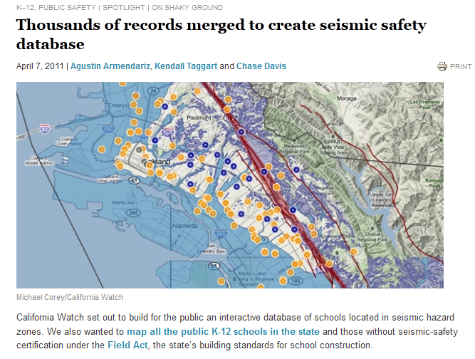

Slide 31
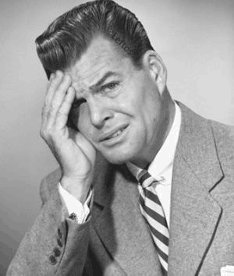
Sometimes, there is no data.
But it’s okay because there are techniques for sampling and building a database.

Slide 32
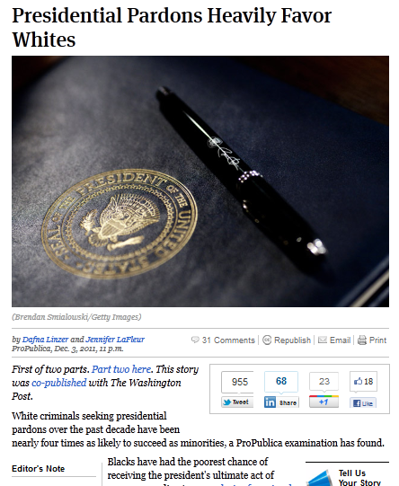
ProPublica pulled a random sample of 500 names from a list of individuals who had been granted or denied pardons (around 2,000). We created a database from months or researching individuals: their crime, age, sentence…
We found that even after controlling for other factors, whites were more likely to get a pardon.

Slide 33
Cleaning data

Slide 34
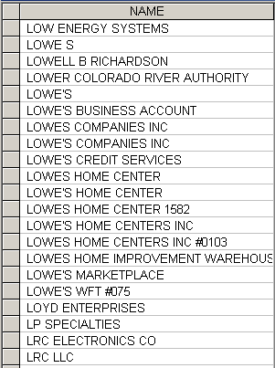
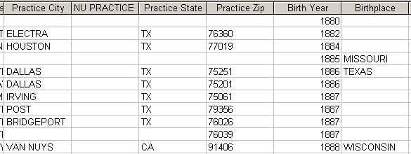
Remember that data are not perfect

Slide 35
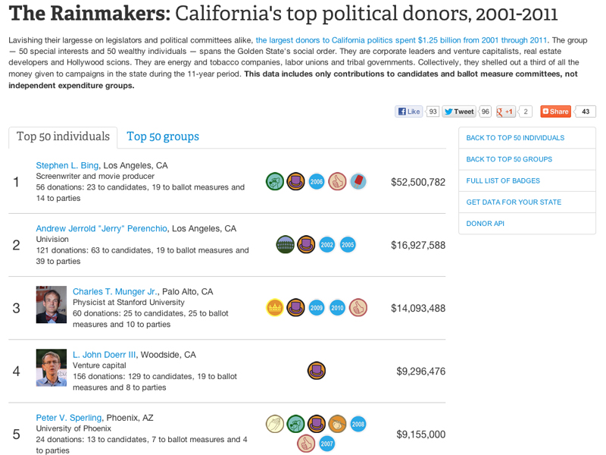
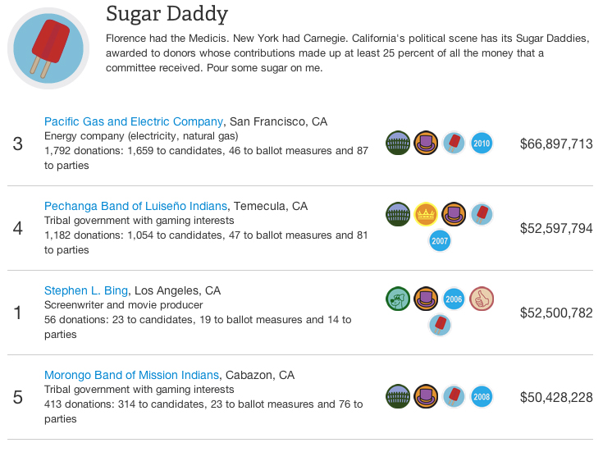
Top donors to state campaigns in California since 2001
Who are they and what do they care about?
Notes:
35

Slide 36
It doesn’t mean you can’t use it…
Do integrity checks to find the flaws
Add caveats where necessary
Do your own analysis rather than relying on an agency’s analysis of bad data

Slide 37
Integrity checks for every data set
Read the documentation. Understand the contents of every field.
Know how many records you should have.
Check counts and totals against reports.
Are all possibilities included? All states, all counties, correct ranges?

Slide 38
Integrity checks for every data set
Internal data checks:
Is there more money going to sub-contractors than went to the prime contractor?
Are there more teachers than students?
Do people have birth dates in the future or so long ago they would be long gone?

Slide 39
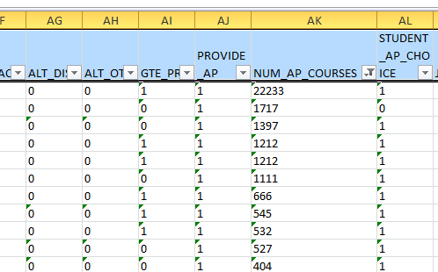
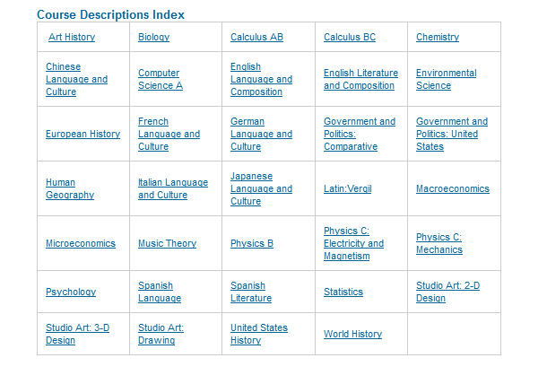

Slide 40
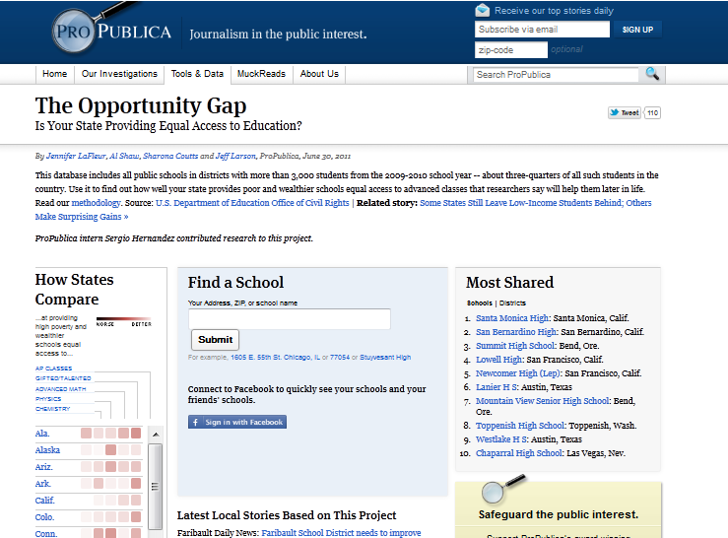
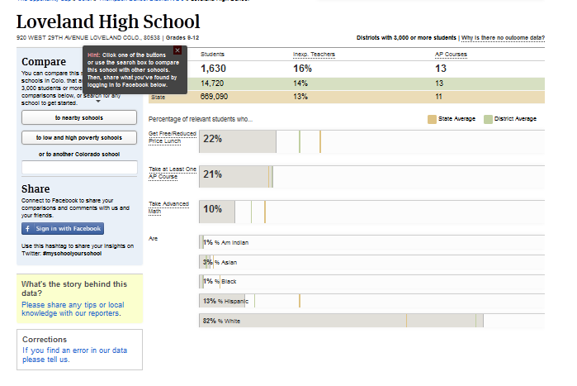

Slide 41
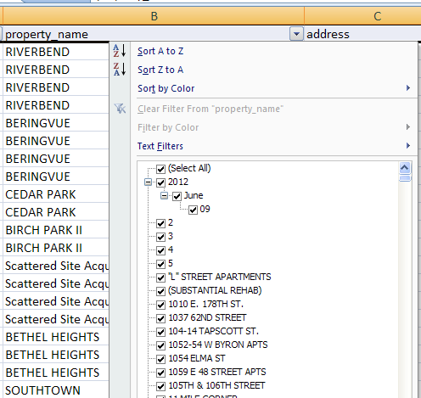
If your data is in Excel, use the filter function to see what the values are in individual fields.

Slide 42
Integrity checks for every data set
Check for missing or misplaced data
Use a standard naming convention for files and tables (I wouldn’t recommend “final”)
Check for duplicates
Take margins of error into account if necessary

Slide 43
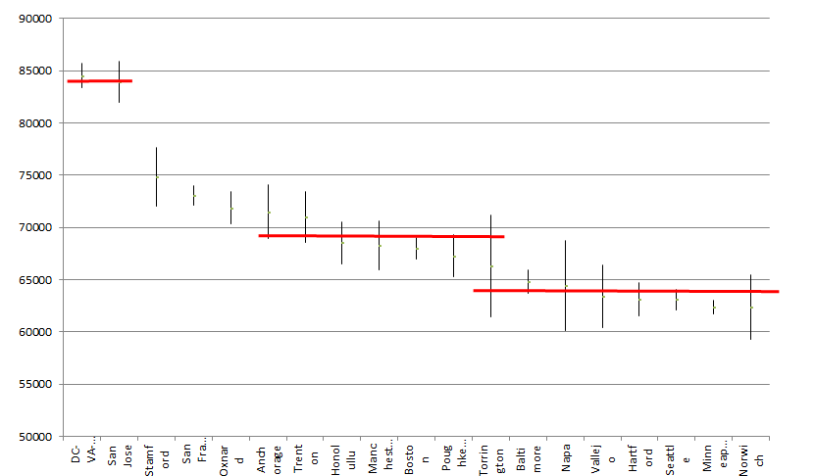
2010 Census ACS: Median HH Income by Metro Area

Slide 44
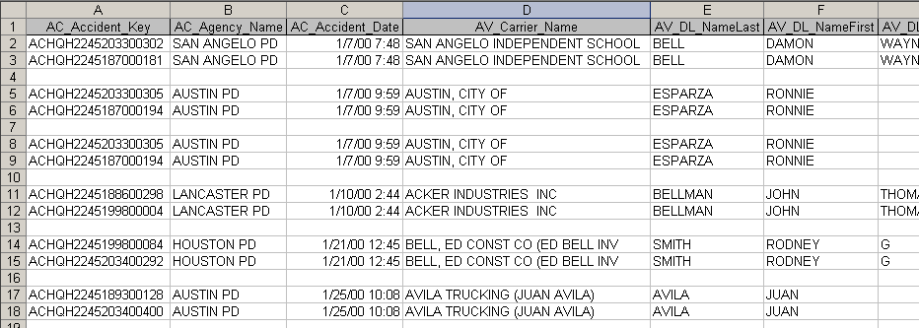
Be creative when you look for duplicates

Slide 45
Beyond the basics
Keep a notes file
Don’t work off your original database
Know the source
Check against summary reports
Use the right tool
Check for outliers when it comes to ups and downs

Slide 46
Truck accidents by year and agency

Slide 47
Beyond the basics
Check with experts
Are there standards? (ex: a drop by more than 10 perc pts is a red flag)
Find out what others have done
Gut check
Go physically see a record or spot check against documents

Slide 48
Voter Fraud
Dozens of St. Louis voters are being wrongly accused of casting ballots from fraudulent addresses in last year's Nov. 7 election.
They are among thousands of registered voters who, based on city property records, appear to live on vacant lots.

Slide 49
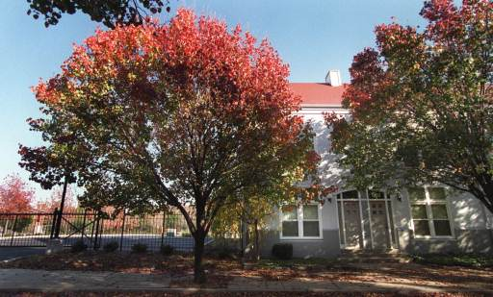

Slide 50
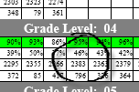
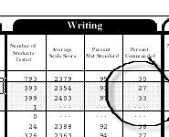
Texas test score data official
results versus district
Duncanville district reported 4th grade writing
Official report for Duncanville 4th grade writing
Courtesy Holly Hacker, The Dallas Morning News

Slide 51
Three rounds of analysis after bouncing off subjects and experts
Demographically based
Voir dire
Socioeconomics

Slide 52
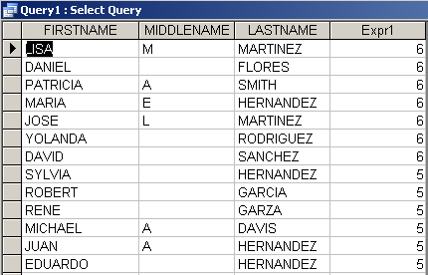
Checks when you’re matching data
A name is not enough. Lots of people have the same name
Get dates of birth and other information to make sure you have the correct person.

Slide 53
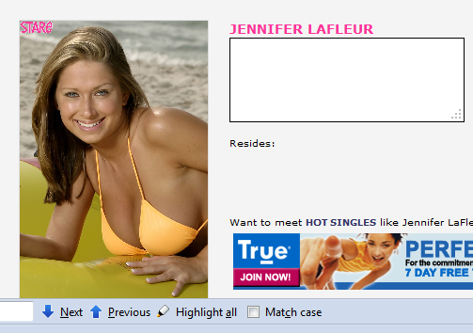
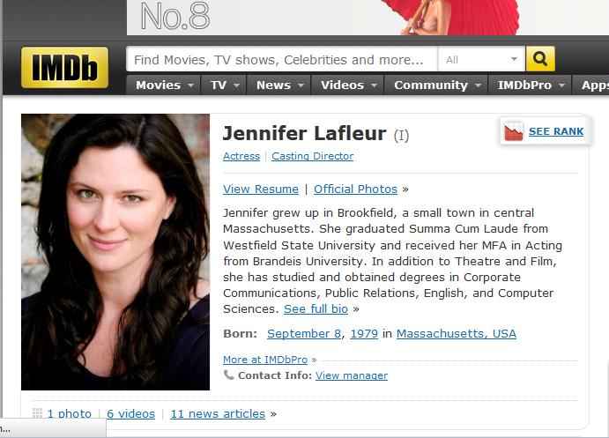
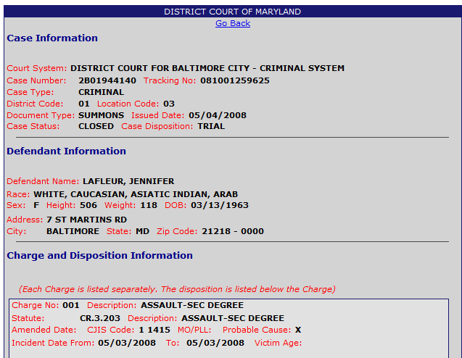
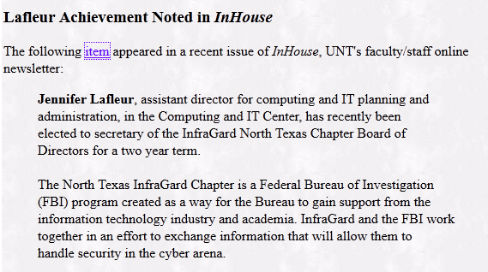
Even people with seemingly unique names aren’t so unique

Slide 54
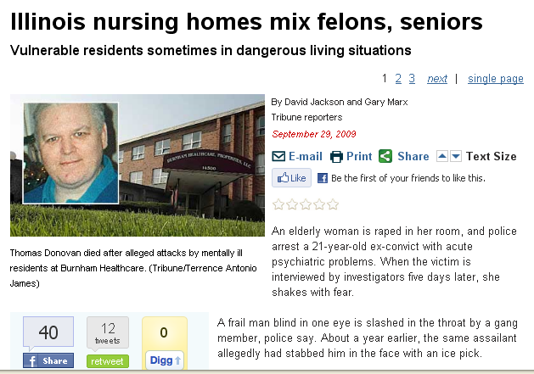
Source: Illinois health data, police data
Findings: Dangerous systemic failed to protect elderly patients in Illinois nursing homes that also house mentally ill younger residents, including murderers, sex offenders, and armed robbers.

Slide 55
Reporting studies by others
Get the questionnaire and methodology
Beware of nonscientific methods: Web surveys, man on the street
Know the sample size..sampling error
Account for margin of error and non-response when drawing conclusions
Run statistical tests on the data if possible

Slide 56
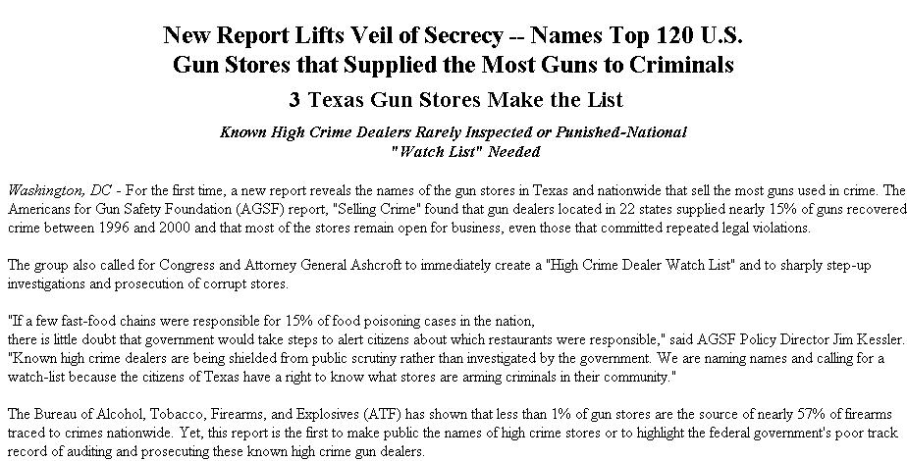

Slide 57
Reporting data
Consider reporting rates not raw numbers
Avoid false precision: 53.14 percent said … in a poll with a 5 percentage point margin of error
Avoid number overload. About half is usually just as useful as 51 percent in most cases
Adjust money for inflation
When analyzing income, use median rather than average (Bill Gates factor)

Slide 58
When the data is the problem – you might still have a story
Erroneous government databases – can often be a story themselves

Slide 59
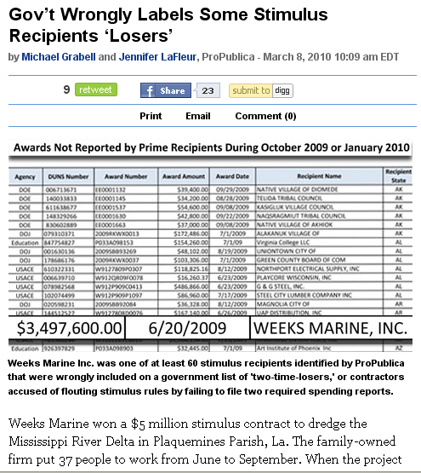

Slide 60
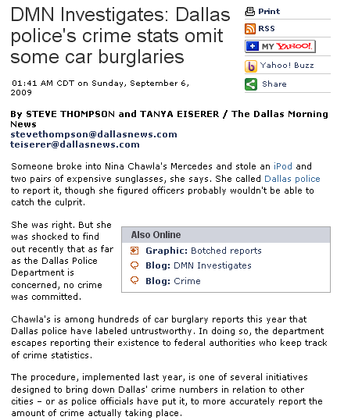

Slide 61
Manipulating data for stories and apps

Slide 62
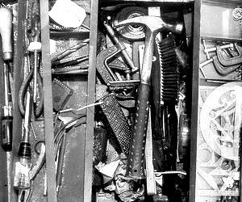
Where’s the data?
Know which tool to use
Reporting individual records
Counting/summing
Mapping
Statistics

Slide 63
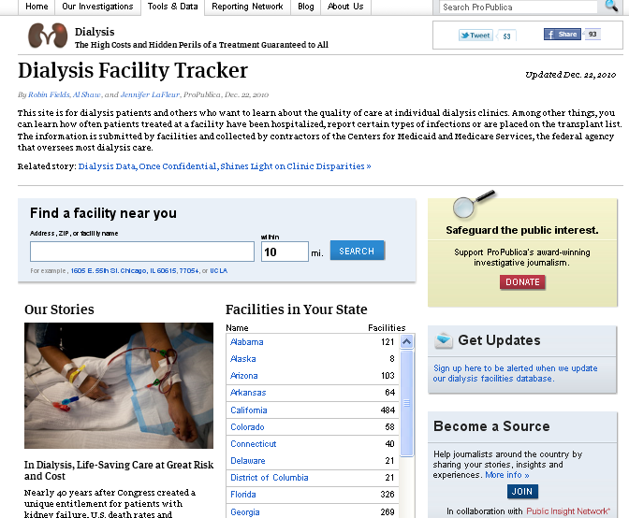
Source: Medicaid outcomes data for dialysis facilities
Findings: A CMS online tool did not tell the whole story about facilities. In some counties the gap in measures, such as survival rate were vast.

Slide 65
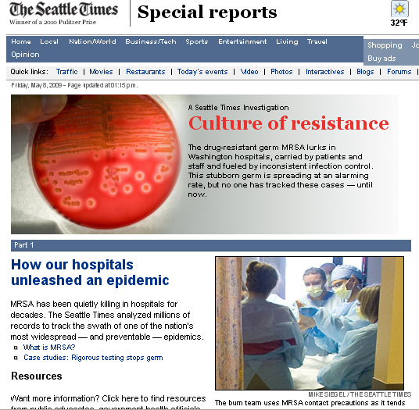
Source: Washington Health Department data
Findings: “MRSA has been quietly killing in hospitals for decades.” But no one had tracked it until this story.

Slide 66
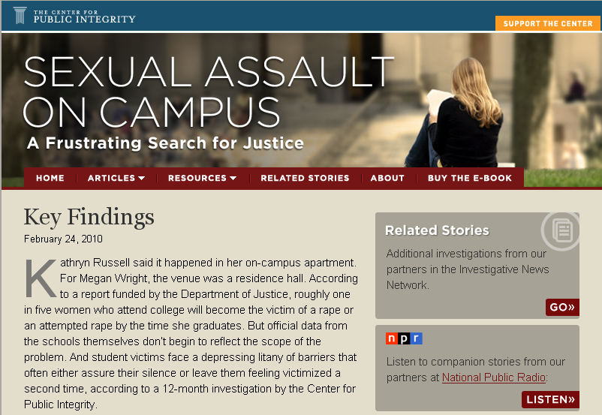
Source: Dept. of Ed data and surveys of campus crisis clinics
Findings: Many campuses had lax enforcement and reporting loop holes mean problems go unchecked.

Slide 67
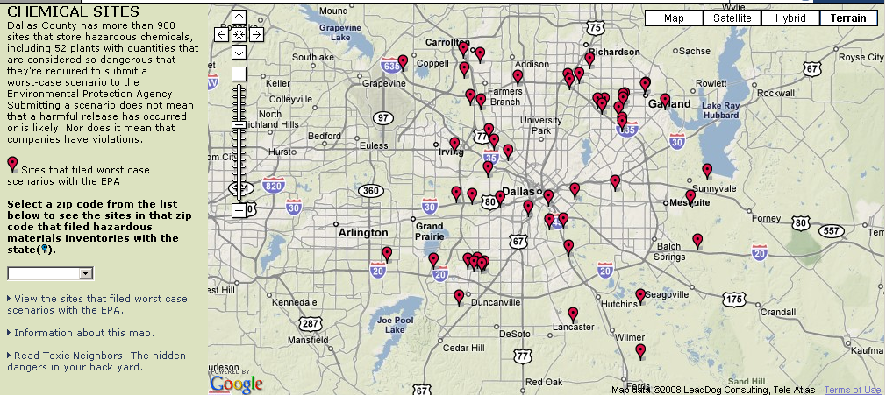
Source: EPA and state data on hazardous chemical locations
Findings: Dallas County has 900+ sites that store hazardous chemicals

Slide 68
Source: Dam inspection data from Texas and federal government
Findings: Dam records had not been updated to account for population growth

Slide 69
Source: 311 calls for downed trees
Findings: After a tornado swept across New York City, 311 calls for downed trees helps trace its path

Slide 71
Source: City Budget
Findings: Some neighborhoods suffer more than others as mayor cuts budgets

Slide 74
Disparities in water usage
“Water use highest in poor areas of the city”
Mapping and statistical analysis

