Slide 1
Getting to Yes
IRE 2012
Jennifer LaFleur, ProPublica

Slide 2
Just another way of saying no
Huge costs
Delay tactics
“Oh, you silly little journalist”
Sending you the wrong thing
“Your request was unclear”
HIPAA
Privacy
Privatization

Slide 3
Turning No into Yes
Know the law
Do your homework
Be persistent
Appeal
Who else has the same records?
Check retention schedules
Ask for record layout for electronic records

Slide 4
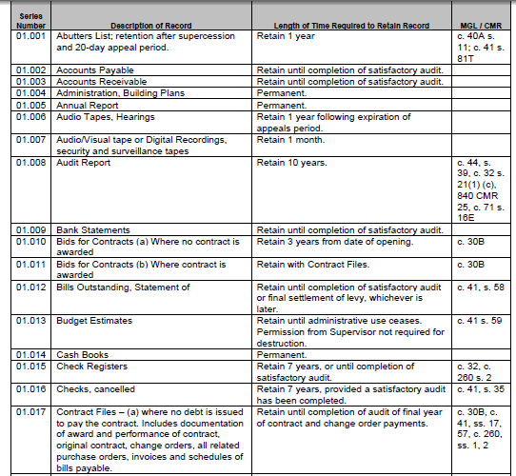
Massachusetts municipal records retention: http://www.sec.state.ma.us/arc/arcpdf/MA_Municipal_Records_Retention_Manual.pdf

Slide 5
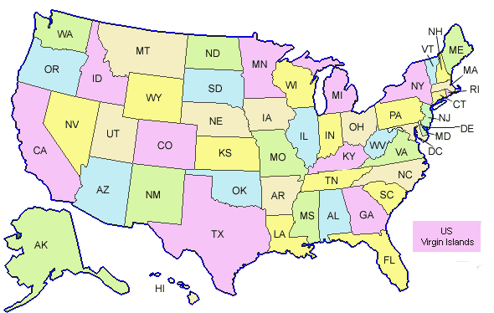
State records laws
Many are similar to FOIA – but differ as what organizations are covered, exemptions and procedures.
Some states have an administrative appeal process.
TX – Required to go to AG
MO – Rep must ask for ruling
CA – Good luck

Slide 6
Negotiating: Some examples

Slide 7
Our database is on a mainframe and it’s very complicated, Missy

Slide 9
We don’t have the authority to do that

Slide 11
That will cost $25,000.

Slide 13
We have processed your request. The labor cost for the request is as follows.
Item # of hours
RESEARCH 20
CREATING FILES 6
CODING 24
TESTING 4
Total (54 X$72) = $3,888.00

Slide 14
111.67. Estimates and Waivers of Public Information Charges
(a) A governmental body is required to provide a requestor with an itemized statement of estimated charges if charges for copies of public information will exceed $40, or if a charge in accordance with §111.65 of this title (relating to Access to Information Where Copies Are Not Requested) will exceed $40 for making public information available for inspection. A governmental body that fails to provide the required statement may not collect more than $40. The itemized statement must be provided free of charge and must contain the following information:

Slide 15
We only keep the information for 7 days

Slide 17
That uses proprietary software.

Slide 19
We don’t keep that on computer

Slide 20
Okay, we do, but it’s a lot of files

Slide 21
That information is protected by law

Slide 24
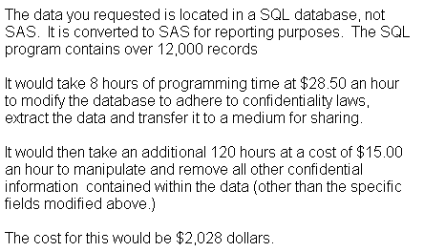

Slide 27
Resources:
Investigative Reporters and Editors – www.ire.org/foia
The Reporters Committee for Freedom of the Press: www.rcfp.org
Justice Department’s FOIA page (includes links to FOIA officials and annual reports) -- http://www.usdoj.gov/04foia/index.html
A copy of this presentation will be available at www.jenster.com/nicar2012

